Slide 1

Globalization of the world economy, its impact on the development of developed and developing countries
Elnur Alasgarov
Huseyn Guliyev

Slide 2
Content
1. Brief information about globalization
2. Globalization index and characteristics
3. For which countries it was good: developed or developing?
4. Have a look at different countries

Slide 3
What is Globalization?
Globalization is the spread of :
Products
Technology
Information
Jobs
across national borders and cultures.
In economic terms, it describes an interdependence of nations around the globe fostered through free trade.

Slide 4
Globalization is a social, cultural, political, and legal phenomenon.
Socially - interaction among various populations.
Culturally - the exchange of ideas, values, and artistic expression among cultures.
A trend toward the development of a single world culture.
Politically - attention to intergovernmental organizations like the United Nations (UN) and the World Trade Organization (WTO).
Legally - how international law is created and enforced.
What is Globalization?

Slide 5
Driving factors of globalization
Advancement in technology
Reduction in the cost of transportation and communication
Taste of individuals and societies
Government policies
The process of industrialization in LDCs

Slide 6
Project analysis slide 8
Advantages and Disadvantages of Globalization
POSITIVE
NEGATIVE
Transfer of Technology
Better Services
Standardization of Living
Development of Infrastructure
Foreign Exchange Reserves
Affordable Products
Extensions of Market
Economic Growth
Growing Inequality
Increasing of the Unemployment rate
Trade Imbalance
Environmental Loots
Homogenization

Slide 7
KOF Globalization index
The KOFGI is a composite index that measures globalization along the economic, social and political dimension.
KOF Globalization index
Economic
Political
Social
Trade Globalization Index
Financial Globalization Index
Interpersonal
Informational
Cultural

Slide 8
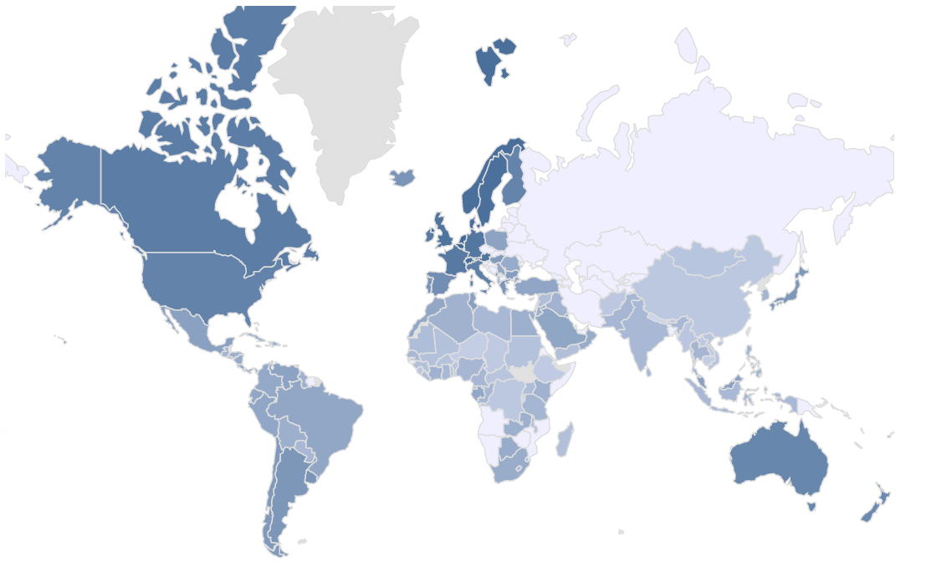
Globalization Index, 1970

Slide 9
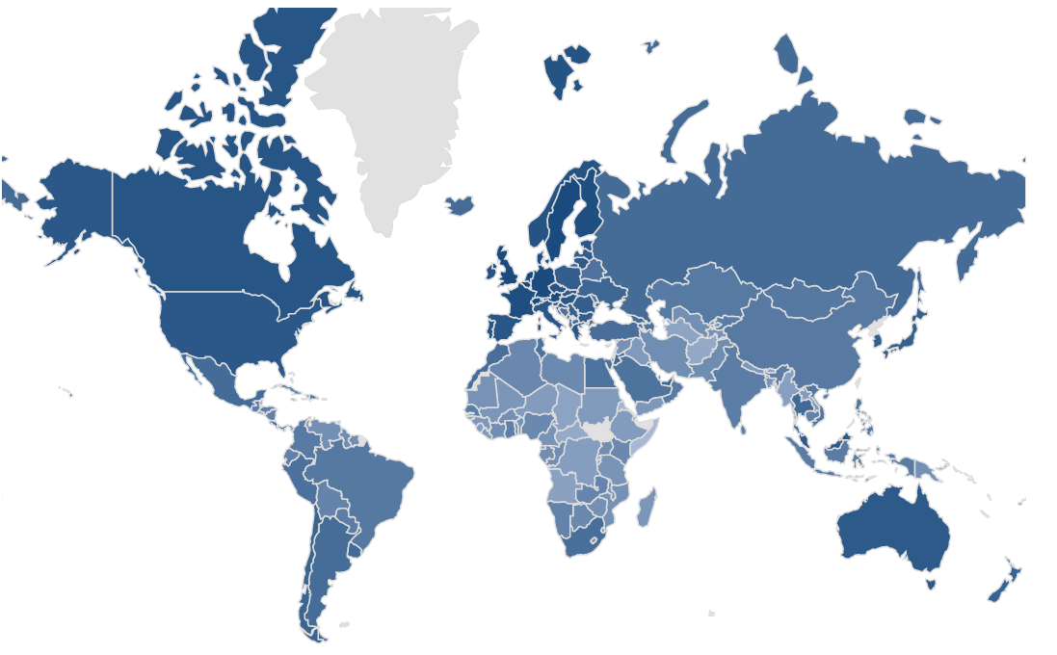
Globalization Index, 2018

Slide 10
Countries with highest GI

Slide 11
For which countries it was good: developed or developing?
9% higher GDP per capita
1 unit more in index
Correlation - strong positive (0.85)
Line equation:
log(GDP per capita) = 2.87 + 0.09 * KOFGI
Relationship - statistically significant
R2 value = 0.72
Total: 153 countries

Slide 12
For which countries it was good: developed or developing?
Correlation - strong positive (0.85)
Line equation:
LOG(GDP per capita) = 0.08 * KOFGI + 3.32
Relationship - statistically significant
R2 value = 0.57
8% higher GDP p.c.
1 unit more in index
Total: 124 countries

Slide 13
For which countries it was good: developed or developing?
2% higher GDP per capita
Correlation - weak positive (0.26)
Line equation:
LOG(GDP per capita) = 0.02 * KOFGI + 8.46
Relationship - statistically insignificant
R2 value = 0.06
1 unit more index
Total: 29 countries

Slide 14

Have a look at various countries:
Highest relationship between Globalization Index and log( GDP per capita ) over years
Country | A unit increase in GI increased GDP p. c. : | Correlation coefficient
1. USA | 8.97% | 0.981
2. Singapore | 12.11% | 0.980
3. Lithuania | 9.29% | 0.980

Slide 15
Have a look at various countries:
Lowest relationship between Globalization Index and log( GDP per capita ) over years
Country | A unit increase in GI increased GDP per cap. : | Correlation coefficient
1. Cayman Islands | -7.51 % | -0.892
2. Zimbabwe | 0.33 % | 0.073
3. San Marino | 1.67 % | 0.287

Slide 16
Correlation: 0.957 (strong positive)
Log(GDP per cap.) = 0.108 * GI + 1.91
Unit increase in GI increases GDP per capita 10.8%
Have a look at various countries:
Azerbaijan

Slide 17
Sources
https://kof.ethz.ch/en/forecasts-and-indicators/indicators/kof-globalisation-index.html
https://www.worldbank.org/

Slide 18
THANKS FOR
ATTENTION

